Slide 1

Inter process Communication
Er. Deeyoranjan Dongol

Slide 2
IPC
Processes within a system may be independent or cooperating
Independent process cannot affect (or be affected) by results of another process
Cooperating process can affect (or be affected) by results of another process
Advantages of process cooperation
Information sharing
Computation speed-up
Modularity
Convenience

Slide 3
IPC
Three problems
How to actually do it?
How to deal with process conflicts?
How to do correct sequencing when dependencies are present?

Slide 4
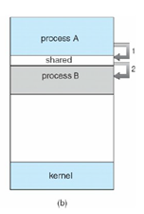
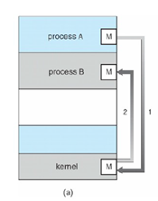
IPC
For fast exchange of information, cooperating processes need some interprocess communication (IPC) mechanisms
Two models of IPC
Message passing
Shared Memory
Notes:
Shared Memory:
– Here a region of memory that is shared by co-operating process is established.
– Process can exchange the information by reading and writing data to the shared region.
– Shared memory allows maximum speed and convenience of communication as it can be done at the
speed of memory within the computer.
– System calls are required only to establish shared memory regions. Once shared memory is
established no assistance from the kernel is required, all access are treated as routine memory
access.
Message Passing:
– communication takes place by means of messages exchanged between the co-operating process
– Message passing is useful for exchanging the smaller amount of data since no conflict need to be
avoided.
– Easier to implement than shared memory.
– Slower than that of Shared memory as message passing system are typically implemented using
system call which requires more time consuming task of Kernel intervention.

Slide 5
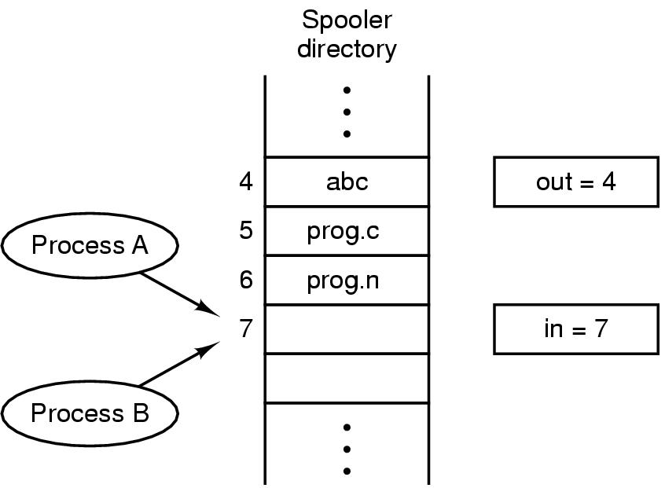
RACE CONDITION
In is local variable containing pointer to next free slot
Out is local variable pointing to next file to be printed
Notes:
Imagine that our spooler directory has a large number of slots, numbered 0, 1, 2, ..., each one capable of
holding a file name. Also imagine that there are two shared variables,
out: which points to the next file to be printed
in: which points to the next free slot in the directory.
At a certain instant, slots 0 to 3 are empty (the files have already been printed) and slots 4 to 6 are full
(with the names of files to be printed). More or less simultaneously, processes A and B decide they
want to queue a file for printing as shown in the fig.
Process A reads in and stores the value, 7, in a local variable called next_free_slot. Just then a clock
interrupt occurs and the CPU decides that process A has run long enough, so it switches to process B.
Process B also reads in, and also gets a 7, so it stores the name of its file in slot 7 and updates in to be
an 8. Then it goes off and does other things.
Eventually, process A runs again, starting from the place it left off last time. It looks at next_free_slot,
finds a 7 there, and writes its file name in slot 7, erasing the name that process B just put there. Then it
computes next_free_slot + 1, which is 8, and sets in to 8. The spooler directory is now internally
consistent, so the printer daemon will not notice anything wrong, but process B will never receive any
output.

Slide 6
RACE CONDITION
Four conditions for avoiding race condition
No two processes may be simultaneously inside their critical regions
No assumptions may be made about speeds or number of CPUs
No process running outside its critical region may block other processes
No process should have to wait forever to enter its critical region

Slide 7
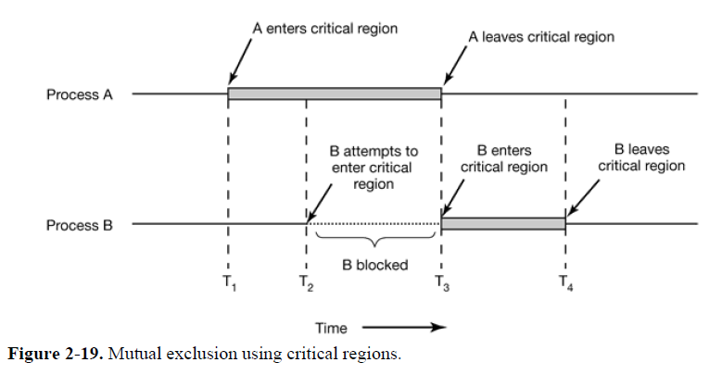
CRITICAL REGION OR CRITICAL SECTION
Notes:
Mutual Exclusion is someway of making sure that if one process is using a shared variable or file, the other processes will be excluded from doing the
same things
That part of the program where the shared memory is accessed is called the critical region or critical section

Slide 8
MUTUAL EXCLUSION WITH BUSY WAITING
Disabling Interrupts
Lock Variables
Strict Alternation
Peterson’s Solution
Test and Set Lock (TSL) Instruction

Slide 9
DISABLING INTERRUPTS
Make process disable the interrupt
Context switching doesn’t happen
A process can update shared memory without fear that any other process will intervene
Problem - User processes never turns it on
- Multiple processor

Slide 10
LOCK VARIABLES
Single shared variable
Initial value = 0
When lock = 0, process turns it to 1 and enters into critical region
When exiting from critical region , turns lock to 0
Problem- Race condition
No Mutual Exclusion
Notes:
Suppose that one process reads the lock and sees that it is 0.
Before it can set the lock to 1, another process is scheduled, runs, and sets the lock to 1.
When the first process runs again, it will also set the lock to 1, and
two processes will be in their critical regions at the same time.

Slide 11
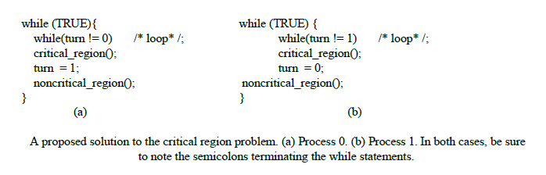
STRICT ALTERNATION

Slide 12
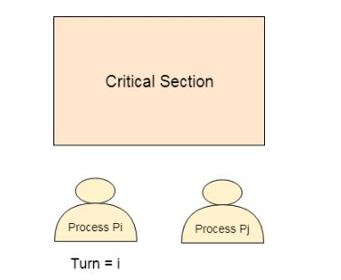
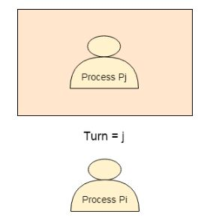
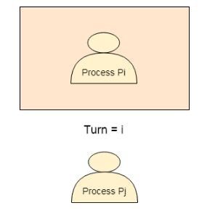
STRICT ALTERNATION
Notes:
This situation violates the condition 3 set above

Slide 13
STRICT ALTERNATION
DRAWBACK
Process 0 finishes the critical region it sets turn to 1 to allow process 1 to enter critical region
Suppose that process 1 finishes its critical region quickly so both process are in their noncritical region with turn sets to 0
Process 0 executes its whole loop quickly, exiting its critical region & setting turn to 1. At this point turn is 1 and both processes are executing in their noncritical regions
Suddenly, process 0 finishes its noncritical region and goes back to the top of its loop. Unfortunately, it is not permitted to enter its critical region now since turn is 1 and process 1 is busy with its noncritical region
Mutual Exclusion, Progress, Bounded waiting
Notes:
This situation violates the condition 3 set above

Slide 14
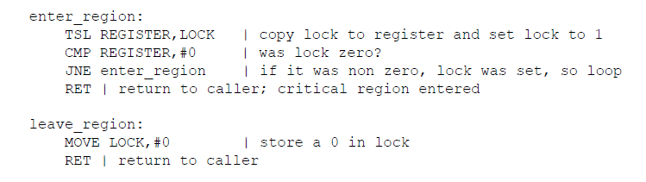
TEST AND SET LOCK (TSL) INSTRUCTION
Mutual Exclusion, Progress, Bounded waiting

Slide 15
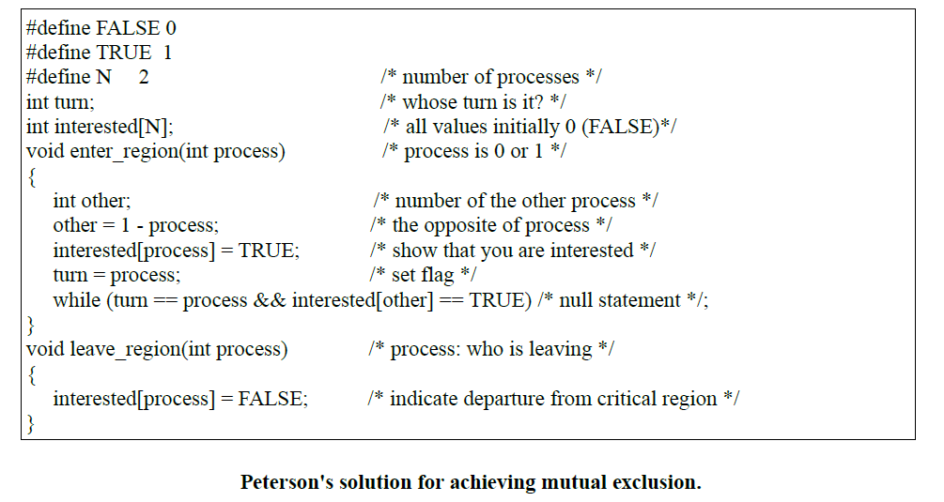
PETERSON’S SOLUTION
Mutual Exclusion, Progress, Bounded waiting
Notes:
Initially neither process is in critical region. Now process 0 calls enter_region. It indicates its interest
by setting its array element and sets turn to 0. Since process 1 is not interested, enter_region returns
immediately. If process 1 now calls enter_region, it will hang there until interested[0] goes to FALSE,
an event that only happens when process 0 calls leave_region to exit the critical region.
Now consider the case that both processes call enter_region almost simultaneously. Both will store their
process number in turn. Whichever store is done last is the one that counts; the first one is lost. Suppose
that process 1 stores last, so turn is 1. When both processes come to the while statement, process 0
executes it zero times and enters its critical region. Process 1 loops and does not enter its critical region.

Slide 16
Problem with above techniques
Waste of CPU time
Priority Inversion Problem
Two processes –H (high) and L (Low)
When L is in critical region, H becomes ready to run and waits
L never gets chance to leave critical region
H loops forever

Slide 17
SLEEP AND WAKEUP
Sleep is a system call that causes caller to be blocked until another process wakes it up
Wakeup call contains one parameter, the process to be awakened

Slide 18
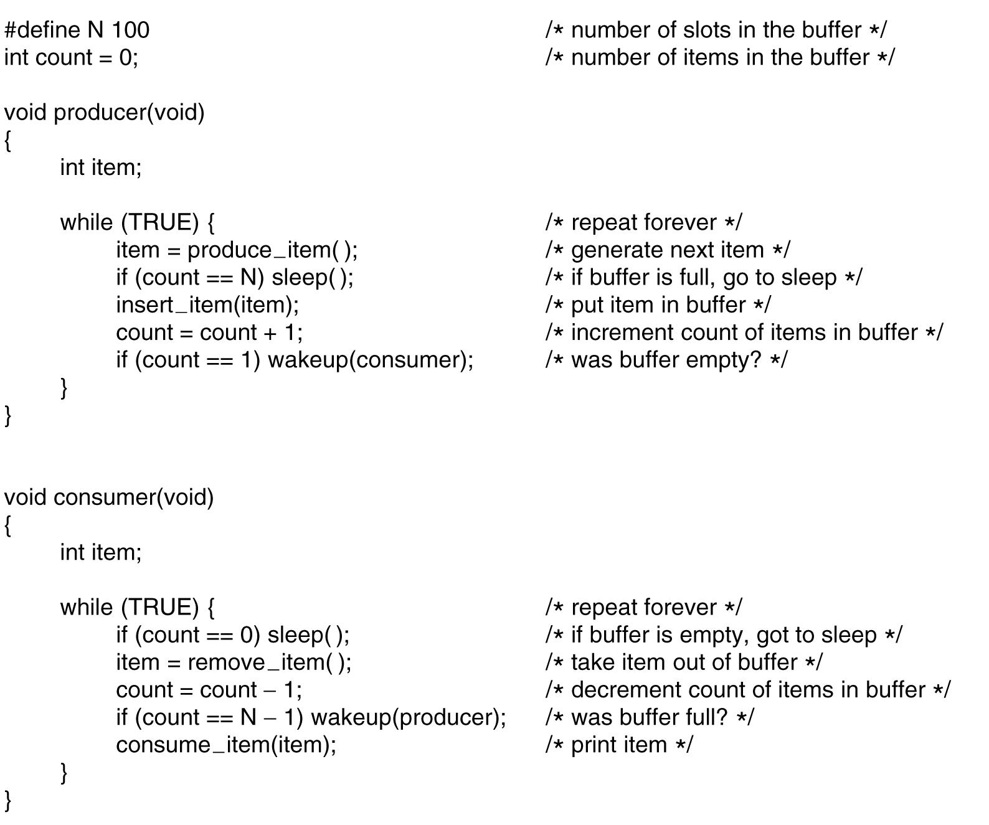
PRODUCER CONSUMER PROBLEM
AKA Bounded Buffer Problem
Notes:
Producers code:
The producers code is first test to see if count is N. If it is, the producer will go to sleep ; if it is not the
producer will add an item and increment count.
Consumer code:
It is similar as of producer. First test count to see if it is 0. If it is, go to sleep; if it nonzero remove an
item and decrement the counter.
Each of the process also tests to see if the other should be awakened and if so wakes it up

Slide 19
PRODUCER CONSUMER PROBLEM
Empty buffer, count ==0
Consumer gets replaced by producer before it goes to sleep
Produces something, count++, sends wakeup to consumer
Consumer not asleep, ignores wakeup, thinks count==0, goes to sleep
Producer fills buffer, goes to sleep
Producer and Consumer sleep forever
Problem is lost wakeup calls

Slide 20
SEMAPHORES
An integer variable that apart from initialization can only be accessed through atomic operations
Two Operations:- down and up
Down checks semaphore. If not zero, decrements semaphore. If zero, process goes to sleep
Up increments semaphore. If more than one process asleep, one is chosen randomly and enters critical region

Slide 21
SEMAPHORES
3 semaphores :- full, empty, mutex
full:- counts number of full slots, initially 0
empty:- counts number of empty slots, initially buffersize
mutex:- controls access to critical region, initially 1
Notes:
Semaphores used for mutual exclusion and synchronization

Slide 22
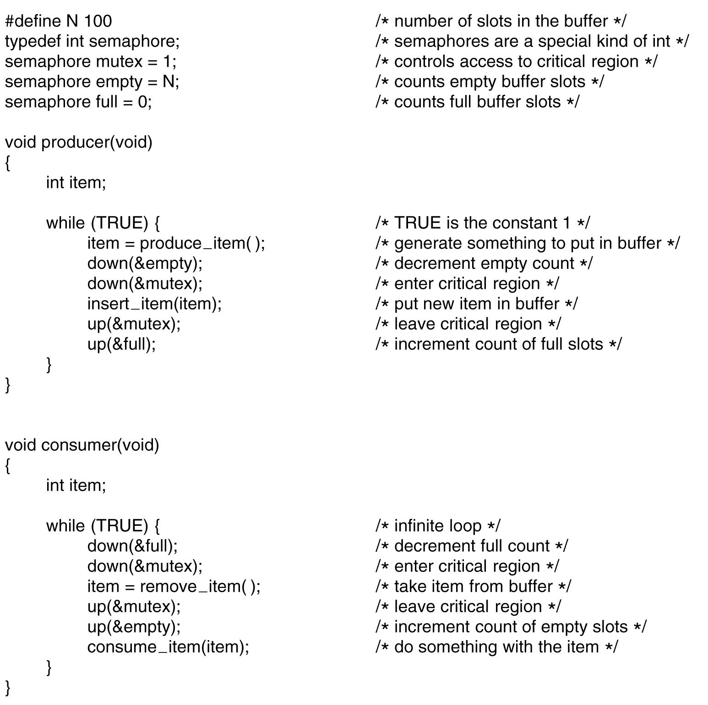
PRODUCER CONSUMER PROBLEM USING SEMAPHORE

Slide 23

CLASSICAL IPC PROBLEMS
Dining Philosophers Problem
N philosophers sit around a circular table eating spaghetti and discussing philosophy.
Each philosopher needs 2 forks to eat,
N forks are available , one between each 2
philosophers.
Philosophers eat/think
Eating needs 2 forks
Pick one fork at a time
Notes:
think until the left fork is available; when it is, pick it up
think until the right fork is available; when it is, pick it up
Eat
put the left fork down
put the right fork down
repeat from the start
After taking the left fork, the program checks to see if the right
fork is available. If it is not, the philosopher puts down the left one, waits for some time, and then repeats the whole process.
All the philosophers could start the algorithm simultaneously, picking up their left forks,
seeing that their right forks were not available, putting down their left forks, waiting, picking up their left forks again simultaneously, and so on, forever.

Slide 24
DINING PHILOSOPHER PROBLEM
Problem
Deadlock
all 5 take their left forks simultaneously
right forks not available
Starvation
pick left fork check for right fork. If not
available put it down.

Slide 25
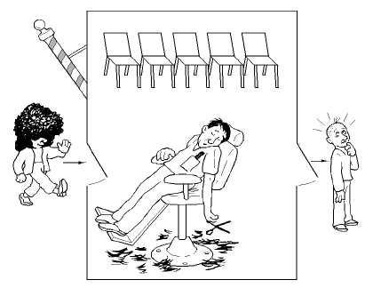
CLASSICAL IPC PROBLEM
The Sleeping Barber Problem
Customer arrive to barber, If no customer barber
sleeps
Barber asleep, customer wake him

Slide 26
CLASSICAL IPC PROBLEM
Problem
Barber waiting and customer waiting
Two customer try to acquire single chair in waiting
room
Solution
mutex allows to acquire one state at a time
Barber checks customer acquire mutex and sleep
or hair cut release it
Customer entering shop acquire mutex and
barber chair or waiting chair release it

Slide 27
CLASSICAL IPC PROBLEM
The Readers and Writers Problem
Models access to database
Airline reservation system
many processes wish to read and write
one process is writing no other process can
access it not even readers

Slide 28
MONITOR
Collection of procedures, variables and data structures all grouped together in a special kind of module
Processes that wish to access the shared data, do through the execution of monitor functions
Only one process can be active in a monitor at any instant
Monitor monitor_name
{
shared variable declarations;
procedure p1(){}
procedure p2(){}
}

Slide 29
MESSAGE PASSING
send(destination, &message);
Sends a message to a given destination
receive(source, &message);
Receives a message from a given source

